Slide 1

Micro Credit Loan
Use Case :
For Telecom Industry

Slide 2
Problem Statement
A Microfinance Institution (MFI) is an organization that offers financial services to low income populations. MFS becomes very useful when targeting especially the unbanked poor families living in remote areas with not much sources of income. The Microfinance services (MFS) provided by MFI are Group Loans, Agricultural Loans, Individual Business Loans and so on.
Many microfinance institutions (MFI), experts and donors are supporting the idea of using mobile financial services (MFS) which they feel are more convenient and efficient, and cost saving, than the traditional high-touch model used since long for the purpose of delivering microfinance services. Though, the MFI industry is primarily focusing on low income families and are very useful in such areas, the implementation of MFS has been uneven with both significant challenges and successes.
Continued……………

Slide 3
This use case is for Telecom Industry. They are a fixed wireless telecommunications network provider. They have launched various products and have developed its business and organization based on the budget operator model, offering better products at Lower Prices to all value conscious customers through a strategy of disruptive innovation that focuses on the subscriber.
They understand the importance of communication and how it affects a person’s life, thus, focusing on providing their services and products to low income families and poor customers that can help them in the need of hour.
They are collaborating with an MFI to provide micro-credit on mobile balances to be paid back in 5 days. The Consumer is believed to be defaulter if he deviates from the path of paying back the loaned amount within the time duration of 5 days. For the loan amount of 5 (in Indonesian Rupiah), payback amount should be 6 (in Indonesian Rupiah), while, for the loan amount of 10 (in Indonesian Rupiah), the payback amount should be 12 (in Indonesian Rupiah).
Continued……………

Slide 4
In order to improve the selection of customers for the credit, I need to build an model that will help client in further investment and improvement in selection of customers.

Slide 5
What is Micro Credit Loan
Microcredit is a common form of microfinance that involves an extremely small loan given to an individual to help them become self-employed or grow a small business.
In Telecom industry it is a service which the telecom can offer to subscribers and resellers both. Through this service, telco can provide ease of access of airtime stock credit to their resellers when they run out of stock balance, without disrupting the normal flow of business. On the subscriber side, they can remain connected without having to recharge through a voucher or digital top-up. This loan is disbursed in real-time and is calculated based on intelligent reseller/subscriber profiling.
When the subscriber or reseller (user) runs out of airtime credit and is unable to recharge, they can dial a USSD code to request for airtime credit. The system will perform user profiling and disburse loans. Next time the user recharges the account, the system will verify if there is any outstanding loan. The loan with a service fee is deducted from the user’s account.

Slide 6
About Dataset
There are 209593 rows and 37 columns in the dataset.
There are 21 column which are of float type.
There are 13 column which are of int type.
There are 3 columns which are of object type.
There is no null values in the dataset.
‘Unwanted : 0’ contains index however data frame has their own index. So, drop it.
1 column is unwanted, 1 column contains only one value for all rows, 7 columns contains above 92% zero values. So, drop it.
From one column ‘pdate’ need to extract day, month & year.
'maxamnt_loans30’ should be 0,6 and 12. Except these three values we need to replace rest value by 0.
Now the dataframe contain 209593 rows and 28 columns.

Slide 7
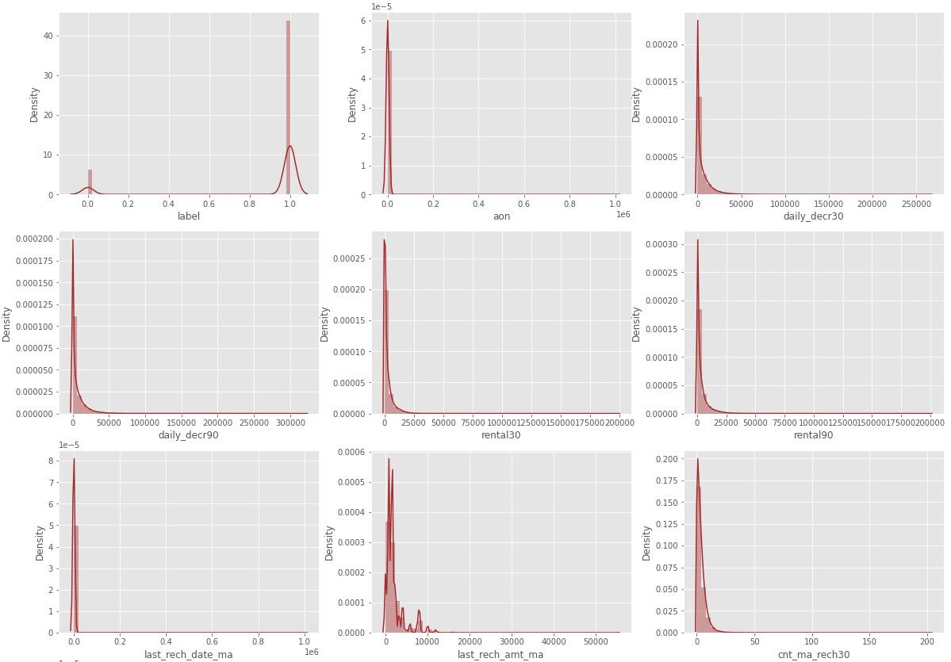
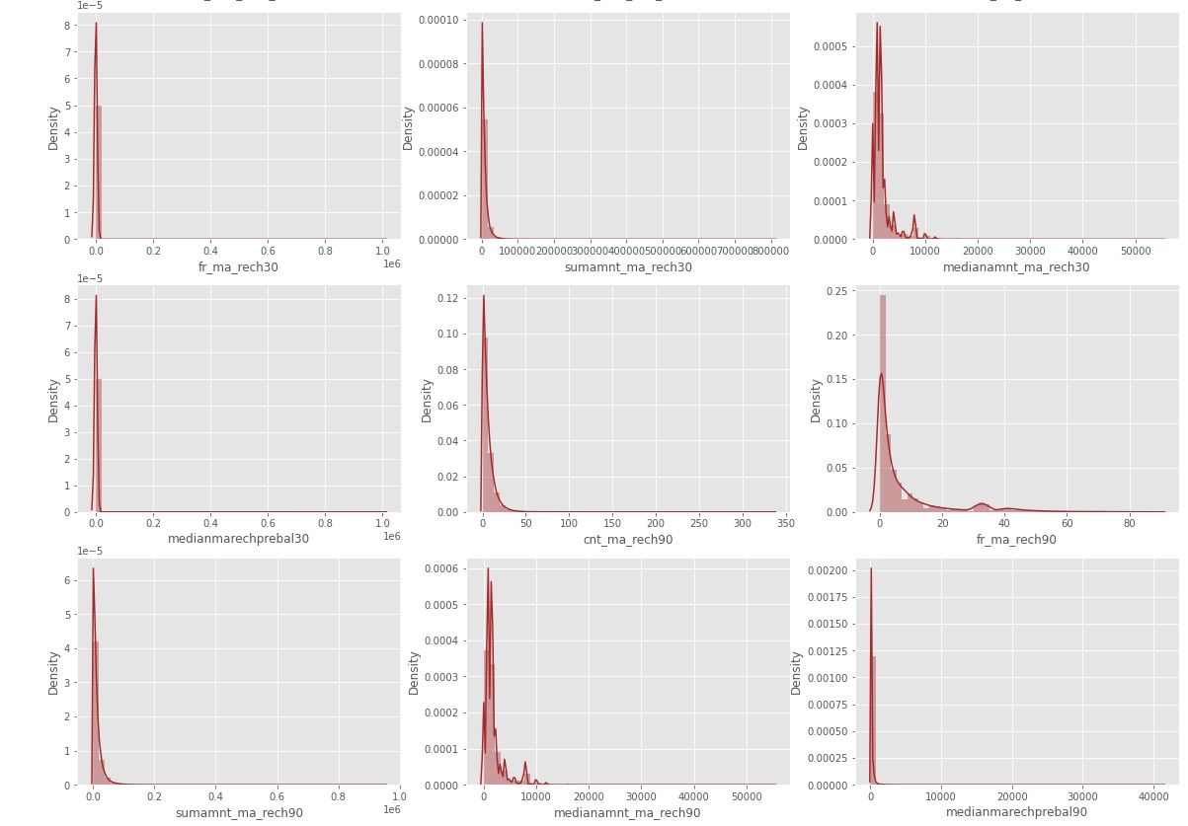
Exploratory Data Analysis
a).Univariate Analysis:

Slide 8
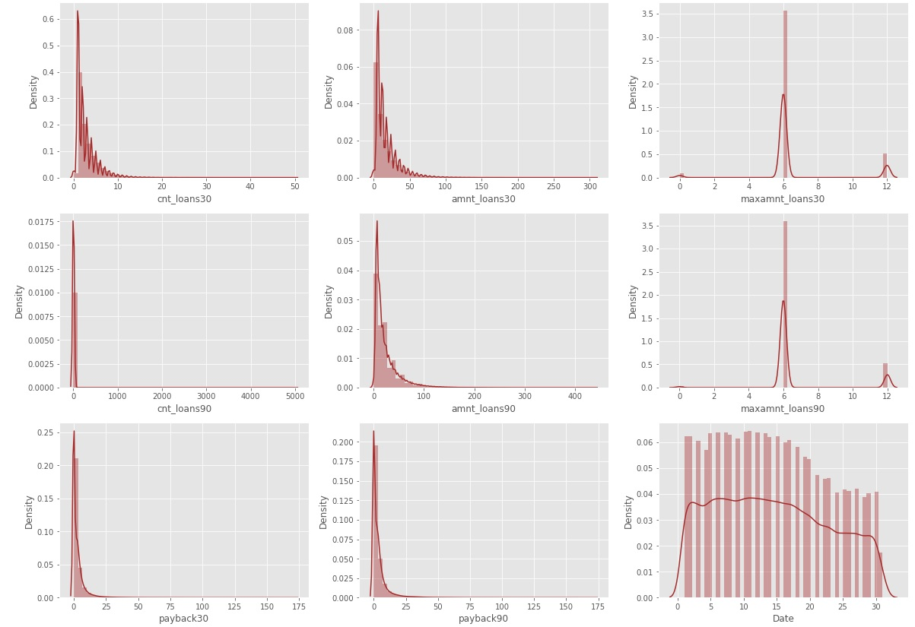
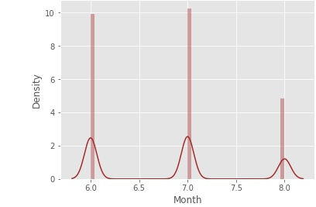
From the graph it can be seen clearly that skewness is present.

Slide 9
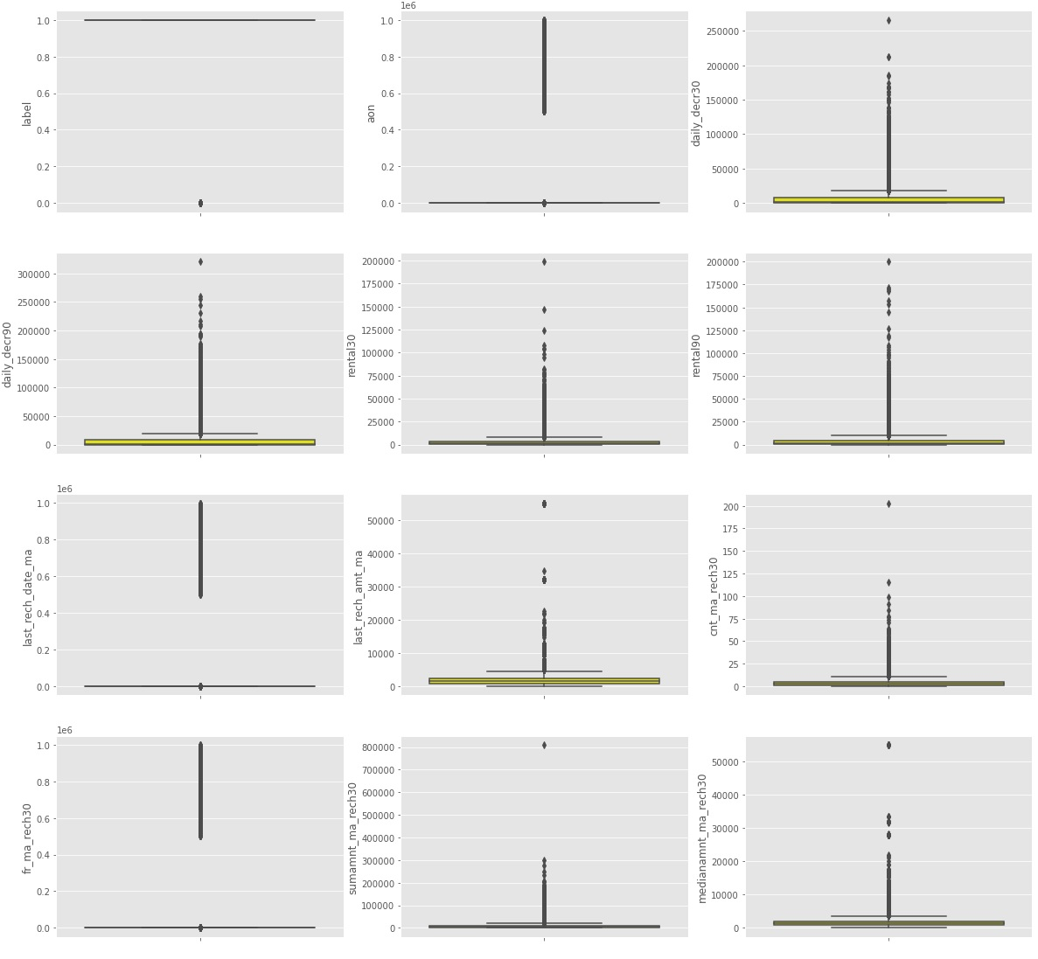
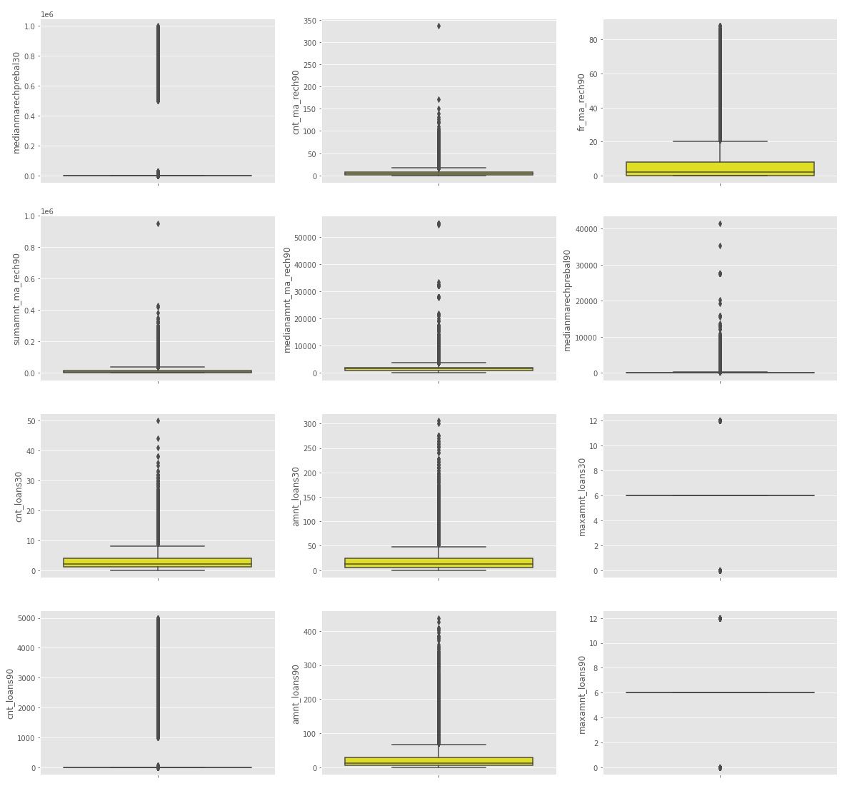

Slide 10
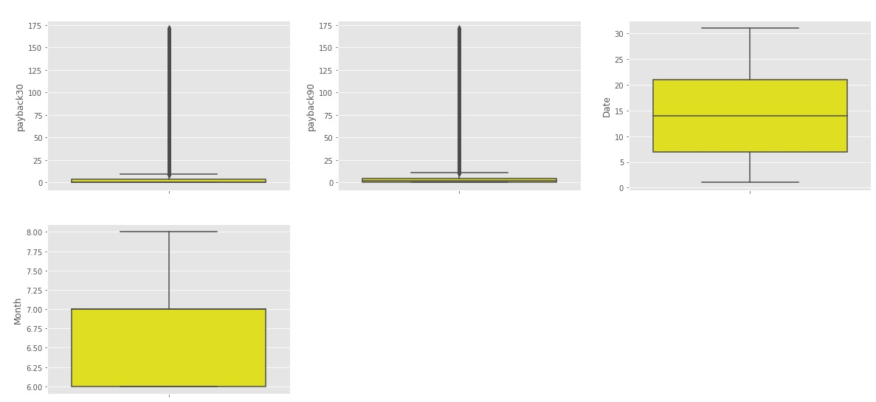
From the graph it can be seen clearly that outliers is also present.

Slide 11
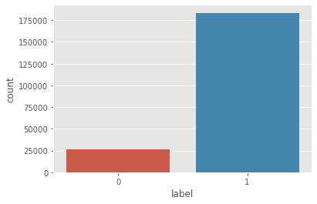
‘label’ is target variable.
From the graph it can be seen clearly that this problem is binary classification problem.
It is also observed that the problem is imbalanced.

Slide 12
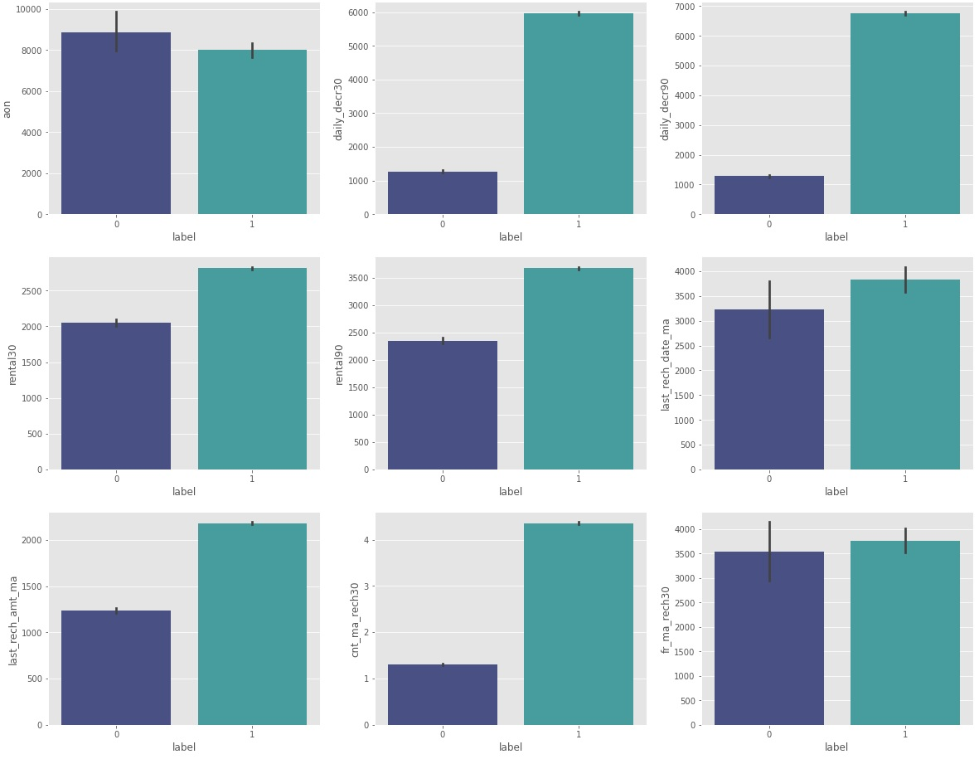
b).bivariate Analysis:
Defaulter are most in ‘aon’.
Non-defaulter are most in ‘daily_decr30’
Non-defaulter are most in ‘daily_decr90’
Non-defaulter are most in ‘rental30’
Non-defaulter are most in ‘rental90’
Non-defaulter are most in ‘last_rech_date_ma’
Non-defaulter are most in ‘last_rech_amt_ma’
Non-defaulter are most in ‘cnt_ma_rech30’
Non-defaulter are most in ‘fr_ma_rech30’

Slide 13
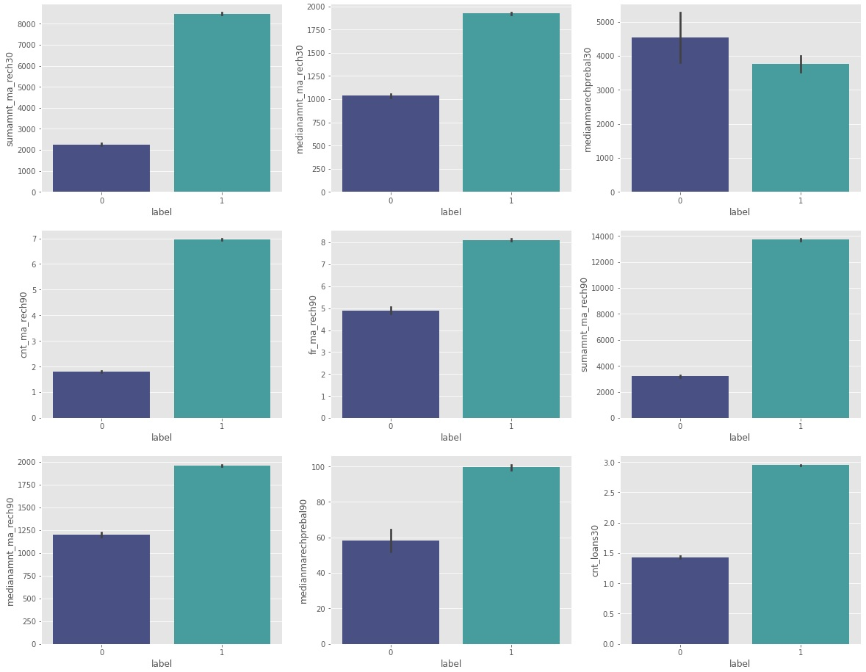
Non-defaulter are most in ‘sumamnt_ma_rech30’
Non-defaulter are most in ‘medianamnt_ma_rech30’
Defaulter are most in ‘medianmarechprebal30’
Non-defaulter are most in ‘cnt_ma_rech90’
Non-defaulter are most in ‘fr_ma_rech90’
Non-defaulter are most in ‘sumamnt_ma_rech90’
Non-defaulter are most in ‘medianamnt_ma_rech90’
Non-defaulter are most in ‘medianmarechprebal90’
Non-defaulter are most in ‘cnt_loans30’

Slide 14
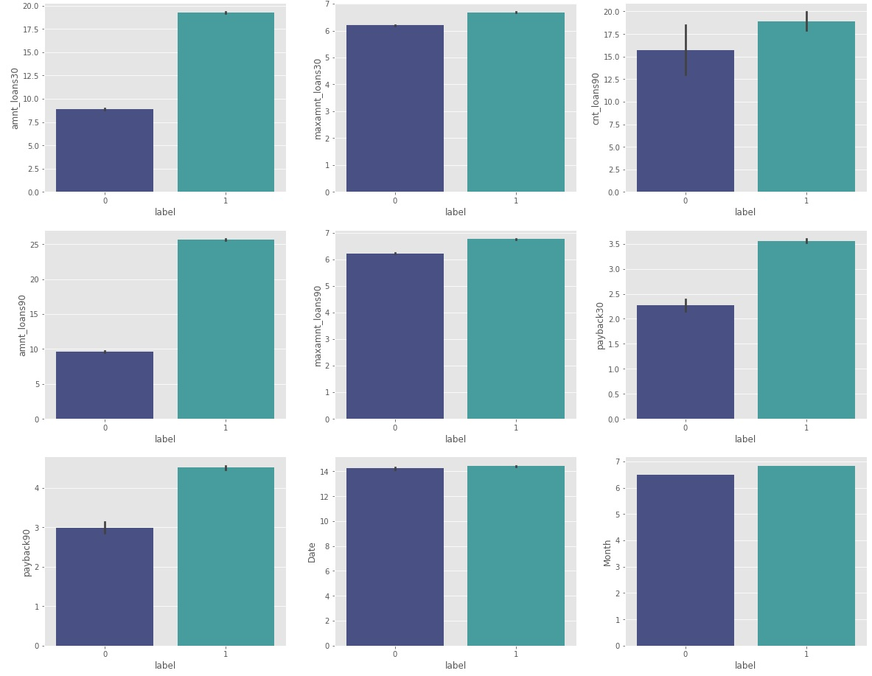
Non-defaulter are most in ‘amnt_loans30’
Non-defaulter are most in ‘maxamnt_loans30’
Non-defaulter are most in ‘cnt_loans90’
Non-defaulter are most in ‘amnt_loans90’
Non-defaulter are most in ‘maxamnt_loans90’
Non-defaulter are most in ‘payback30’
Non-defaulter are most in ‘payback90’
Non-defaulter are most in ‘Date’
Non-defaulter are most in ‘Month’

Slide 15
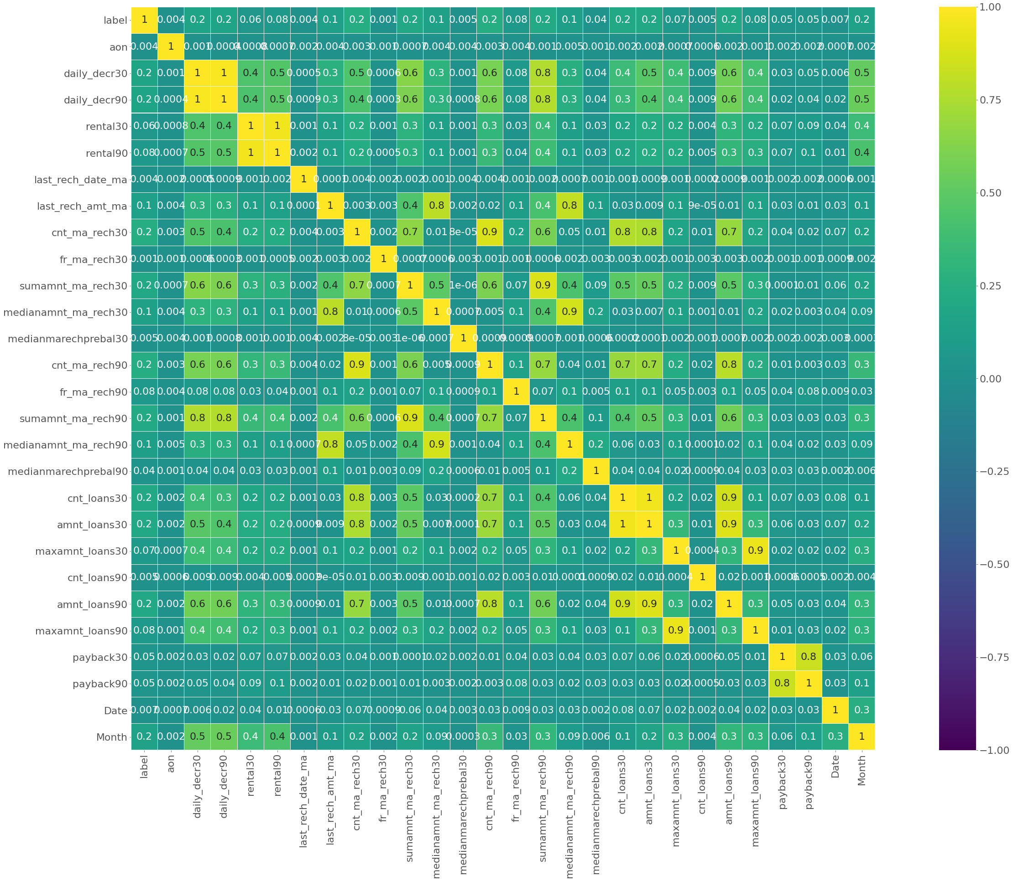
Correlation matrix using Heatmap

Slide 16
Features Engineering
Dealing with Outliers
Using IQR and z-score method, the loss of data is above 7-8%.
Percentile method is able to reduce the outliers under the given condition.
Dealing with Skewness
‘yeo-johnson’ method of Power Transformer is used to remove the skewness.
Scaling the dataset
‘Standard Scaler’ is used to normalize the dataset.
Dealing with Imbalancing
‘Over Sampling’ of SMOTE algorithm is used to deal with imbalancing.

Slide 17
Model Initiating
Find best Random State
Split dataset using Train_Test Split
Model Building
Accuracy Score
Cross-Validation Score
ROC_AUC Curve
& Score

Slide 18
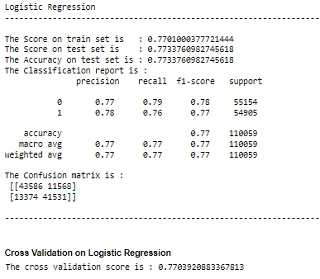
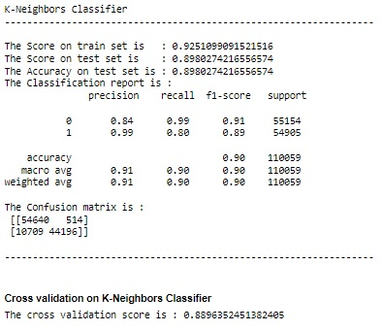
Insights of all Models
Continued…………….

Slide 19
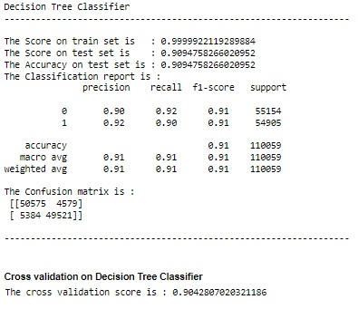
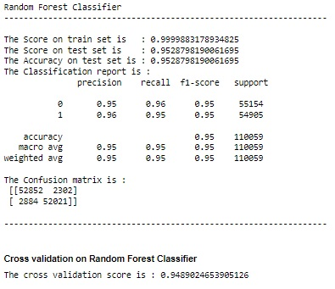
Continued…………….

Slide 20
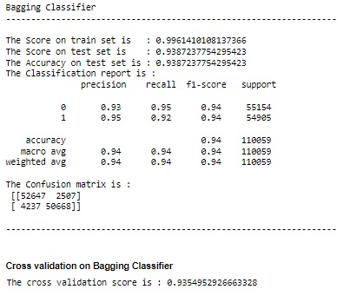
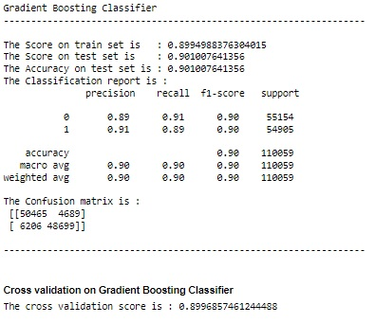
Continued…………….

Slide 21
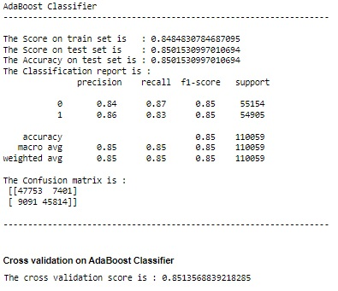
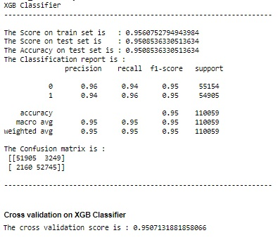

Slide 22
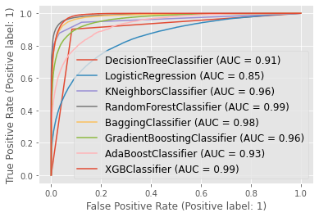
ROC AUC Curve
Random Forest Classifier and XGB Classifier have best score.

Slide 23
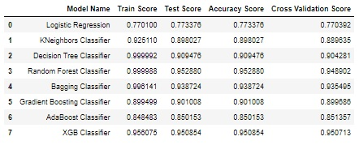
Scores of All Models
Accuracy score of Random Forest Classifier and XGB Classifier are also good. The difference between accuracy score and cross validation score is less for XGB Classifier as compared with Random Forest Classifier. So, XGB Classifier is final model on this dataset.

Slide 24
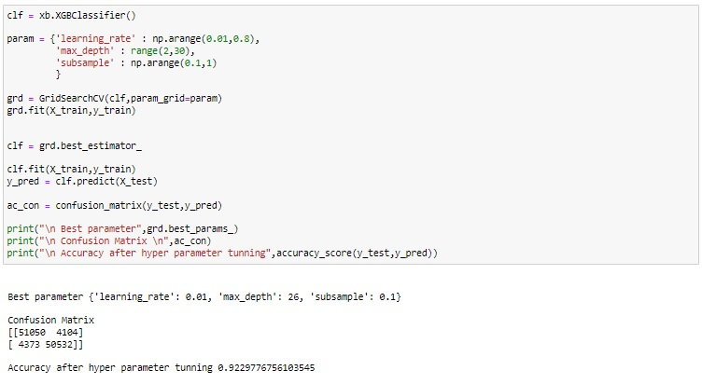
Hyperparameter Tuning
After hyperparameter tuning, not able to improve performance. So, default parameters are best parameters.

Slide 25
Conclusion
Mostly, the customers have the intension of repaying. There are certain cases when the customers have no intension of repayment but the number of such customers are few. With the model built, we can certainly determine those customers having intension of repayment or not.
I used total 8 algorithm to build best model on this dataset.
Random Forest Classifier and XGB Classifier out of 8 model performed better on this dataset.
Comparing both models based on different metrics XGB Classifier is final model on this dataset.
XGB classifier gives 95.08% accurate prediction on test dataset or accuracy of model is 95.08%

Slide 26
Thank You………

